Slide 1
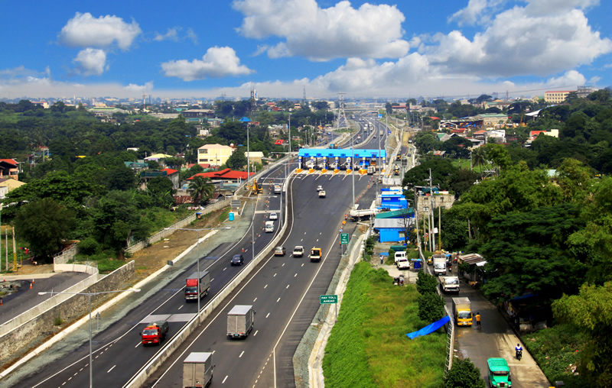
Land Transport Infrastructure Development
STRUCTURING & NEGOTIATING PPP
PROJECT FINANCINGS
Manila
19 November 2014
Andrew Kinloch
Logie Group Limited

Slide 2
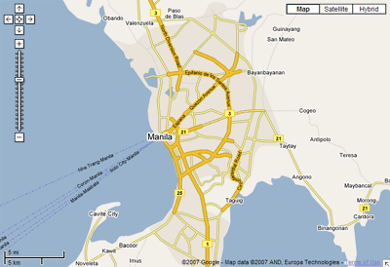
THE PHILIPPINES’ TRACK RECORD IN ROAD PPP
Examples:
North Luzon Expressway
Manila Cavite toll road
Daang Hari – SLEx link road
NAIA Expressway phase 2
…
Cavite – Laguna Expressway
Skyway Stage 3
NLEx – SLex connector

Slide 3
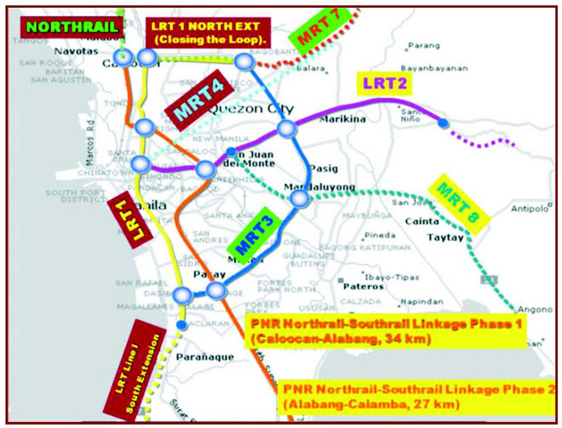
THE PHILIPPINES’ TRACK RECORD IN RAIL PPP
LRT line 3
LRT line 1 Cavite extension
…
MRT line 7
kl

Slide 4
ADVANTAGES OF PPP
Longer term funds available when on project basis
Matches Government outgoings to benefits
Allows injection of technical expertise
Sensible offload of some risk
Gets something built

Slide 5
DISADVANTAGES OF PPP AND WHAT TO DO ABOUT THEM
Higher cost of borrowing
Gold plated assets are expensive
Transaction negotiation costs incl losing bidder costs
Control of the asset
Perception that private sector / foreigners are taking advantage of users / voters
Fear that concession was granted too cheaply

Slide 6
ISSUES IRRESPECTIVE OF FINANCING METHOD
PPP = Properly Prepared Projects
Define project and network within which it sits
Recognise that project often generates benefits which it does not capture
Land acquisition
Traffic volumes usually unknown
Value for Money is always an issue

Slide 7
SENSIBLE ALLOCATION OF RISK & RESPONSIBILITY
Traffic risk
Network design risk
Ground conditions risk
Combining utility and real estate profiles
Project – on – project risk

Slide 8
BENEFITS NOT CAPTURED BY THE PROJECT COMPANY
Increase in real estate values – MRT in Singapore and MTR in HK
Time saved by travelers both using this asset and elsewhere
Cleaner air etc
=> Govt support can thus be justified

Slide 9
ROLE OF THE HOST GOVERNMENT
Set legal and regulatory framework
Powers of eminent domain re land acquisition
Role of numerous Govt departments
Permits and approvals
Role of MOF incl funding of early devt (e.g. PDMF)
Role of PPP Centre: coordination, simplification or direction
Model contracts
Performance of obligations as counterparty

Slide 10
LEGAL & REGULATORY FRAMEWORK
BOT Law
BOT Center
Transparency in bidding process
Negotiations post award
Bid costs
Unsolicited bids
Negotiated contracts
Regulation of prices charged to users v rates of return earned by investors
Nationality concerns

Slide 11
STRUCTURING CONSIDERATIONS – LAND ACQUISITION
Private sector proponent may take some limited land acquisition risk but principal responsibility for this is Govt’s – this can influence the route
Govt needs to handle acquisition of land / right of way then relocation of formal and informal occupants which needs to be fair, generous and speedy
Alternative structures include Govt obligation to buy back project or pay for delay if right of way not secured by a date certain – but not popular!

Slide 12
STRUCTURING CONSIDERATIONS – REVENUE RISK
Private sector will take traffic risk when it thinks that it understands it:
NLex refinancing
Tunnels in NSW and roads in Qld
Recent Philippines deals not tested yet
However, Govt support completely changes risk profile:
Revenue collars in Korea
Viability Gap Funding in India
Availability payments in Vic

Slide 13
STRUCTURING CONSIDERATIONS – UPSIDE SHARING
Align Govt interests with private sector by taking equity
Govt can contribute in kind
Revenue collars (not VGF)
Shadow tolls alongside cash / no actual tolls
Govt to share in refinancing surplus as in the UK

Slide 14
RECOMMENDATIONS
Establish / empower PPP Centre and BOT regime
Capacity build across Govt
Copy what has worked elsewhere
Do not be afraid to offer appropriately structured Government support
Ensure that legal system especially re land acquisition is fair, generous and speedy
Do not be too ambitious in offloading risk
Share the upside
Establish one successful transaction for each sector then replicate this

Slide 15
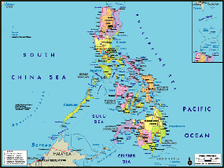
Q & A
andrewkinloch@logiegroup.com
+852 9301 6880
Specialist advice on Infrastructure Finance in Asia

